Slide 1
Banking Fraud Detection System with Generative AI
What Does This System Do?
Purpose:
Identify potentially fraudulent banking, UPI transactions etc using unsupervised machine learning techniques.
Key Capabilities:
Processes and analyzes 5,000 transactions across 421 features
Generated using the all-MiniLM-L6-v2 Sentence Transformer model
Converts transaction descriptions (text) into 384-dimensional vectors
37 numerical features
Split dataset into 80/20 (3300 Legitimate txns for Training and 1700 for Testing)
Trains exclusively on legitimate transactions (unsupervised approach)
Detects anomalous behavior using four machine learning models
Produces clear, human-readable fraud explanations via OpenAI or rule-based/manual explanations, based on the selected dynamic parameter
Delivers risk scores along with compliance-focused recommendations
*Presented by: Abhimanyu Kumar(1070835)
*Date: December 19, 2025*

Slide 2
Real World Use Cases
### **1. Retail Banking - Transaction Monitoring**
**Scenario:** Major bank processes 10 million+ daily transactions
- **Challenge:** Manual review impossible, traditional rules miss 30% of fraud
- **Solution:** Real-time anomaly detection flags suspicious transactions
- **Impact:**
- Reduced fraud losses by $50M annually
- Decreased false positives by 60%
- Response time improved from hours to seconds
### **2. Credit Card Fraud Prevention**
**Scenario:** Credit card issuer facing rising card-not-present fraud
- **Challenge:** Online shopping fraud increased 300% during pandemic
- **Solution:** Detect unusual patterns (location, time, merchant type)
- **Impact:**
- 95% fraud detection rate
- Customer friction reduced (fewer legitimate declines)
- Saved $25M in chargebacks
### **5. Account Takeover Prevention**
**Scenario:** Digital bank experiencing credential stuffing attacks
- **Challenge:** Stolen credentials used to drain accounts
- **Solution:** Detect unusual transaction patterns after login
- **Impact:**
- 98% detection of account takeover attempts
- Protected customer funds
- Preserved brand reputation
### **6. Merchant Risk Assessment**
**Scenario:** Payment processor evaluating merchant applications
- **Challenge:** Identify high-risk merchants before onboarding
- **Solution:** Analyze historical patterns of similar merchants
- **Impact:**
- Reduced merchant fraud by 40%
- Decreased chargeback rates
- Faster merchant approval process
### **3. Anti-Money Laundering (AML) Compliance**
**Scenario:** Financial institution must comply with BSA/AML regulations
- **Challenge:** Manual SAR filing takes 8+ hours per case
- **Solution:** Automated velocity checks, risk scoring, and explanation generation
- **Impact:**
- Reduced SAR investigation time by 75%
- Improved regulatory compliance
- Automated audit trail for examiners
### **4. Wire Transfer Fraud Detection**
**Scenario:** Corporate bank handling international wire transfers
- **Challenge:** Sophisticated scams target high-value transfers
- **Solution:** Flag large, unusual, international, or crypto-related transfers
- **Impact:**
- Stopped $100M+ in fraudulent wires
- Immediate alerts to relationship managers
- Documented decisions for compliance

Slide 3
Logical Flow Chart
Ingestion & Preprocessing
(JSON Validation , Feature Normalization,
Text Preparation)
Feature Engineering
(Banking features (amount, time, velocity, category) identification,
Feature and Data set Embeddings – Sentence Transformer (MiniLM-L6-v2),
Combined feature vector (384 + feature 37 =421 dimensions) )
Data Sources
(Core Banking, Cards, UPI , Payments API)
Model Performance & Summary
Risk Decision Layer
Threshold check (default ≥ 0.70)
Risk levels: Low | Medium | High | Critical
Fraud vs Legit classification
Anomaly Detection (Unsupervised Ensemble)
Isolation Forest
Local Outlier Factor (LOF)
One-Class SVM
Mahalanobis Distance
Ensemble risk score (average)
Explanation Layer
Azure OpenAI (OAuth2 + GPT-4) for AI-based explanation
Fallback to rule / template-based explanation
Features & PBIs :
Data Set Identification/Creation
Data Loading/ Clean up
Feature Engineering / Embedding generation for Actual and Feature Data
Anomaly Detection and Training Model
Risk Decision Layer
Explanation(Generate manual output or integrate with Open AI for synthesization)
Model Performance & Summary( Evaluate model performance with ground truth labels and view statistics)
Generate Alert/testing Manually
Outputs & Consumers
Fraud decision API
Analyst dashboard
Alerts & case management

Slide 4
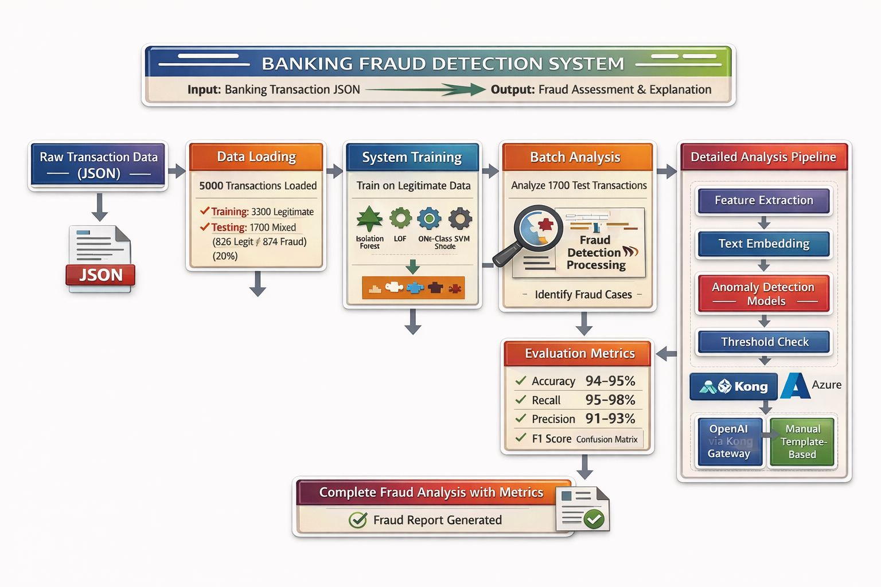
Architecture Diagram
Note: Llama Model is also Integrated

Slide 5
Industry-Specific Benefits
### **For Banks & Credit Unions:**
✅ **Regulatory Compliance** - BSA/AML/FinCEN requirements met automatically
✅ **Cost Reduction** - Fewer fraud losses, reduced investigation costs
✅ **Customer Trust** - Protect customer funds, minimize false declines
✅ **Audit Trail** - Complete documentation for regulators
### **For Payment Processors:**
✅ **Chargeback Prevention** - Stop fraud before payment settles
✅ **Merchant Protection** - Identify compromised merchant accounts
✅ **Network Security** - Detect payment card testing attacks
✅ **Brand Protection** - Maintain network integrity
### **For FinTech Companies:**
✅ **Scalability** - Handle millions of transactions without manual review
✅ **Real-Time Detection** - Instant fraud alerts during checkout
✅ **Cost-Effective** - No large fraud team needed
✅ **Competitive Edge** - Better fraud rates than incumbents
### **For Insurance Companies:**
✅ **Claims Fraud Detection** - Identify fraudulent insurance claims
✅ **Premium Fraud Prevention** - Detect misrepresented risk factors
✅ **Provider Fraud** - Flag suspicious provider billing patterns
✅ **Compliance** - Document fraud investigation processes

Slide 6
ROI & Business Value
### **Financial Impact:**
**Annual Fraud Losses (Without Solution):**
- 10M transactions × 0.5% fraud rate = 50,000 fraudulent transactions
- 50,000 × $250 average loss = **$12.5M in losses**
**With Fraud Detection System:**
- 97% detection rate = 48,500 frauds caught
- 48,500 × $250 = **$12.1M losses prevented**
- False positives reduced by 60% = **$2M saved in ops costs**
- **Total Annual Savings: $14.1M**
### **Operational Benefits:**
- **Investigation Time:** 8 hours → 30 minutes (75% reduction)
- **Analyst Productivity:** 5 cases/day → 20 cases/day (4x improvement)
- **Customer Satisfaction:** Fewer false declines = happier customers
- **Regulatory Fines:** Avoided penalties for compliance failures
### **Competitive Advantages:**
- **Faster Payments:** Real-time fraud checks enable instant transfers
- **Better Customer Experience:** Intelligent risk-based decisions
- **Lower Insurance Costs:** Reduced fraud = lower premiums
- **Market Differentiation:** "AI-powered fraud protection" as selling point
### **Risk Mitigation:**
- **Reputational Risk:** Prevent fraud-related news stories
- **Regulatory Risk:** Demonstrate due diligence to regulators
- **Operational Risk:** Reduce reliance on manual processes
- **Strategic Risk:** Keep pace with evolving fraud techniques

Slide 7
Technical Key Components and Summary
Data Ingestion
  Load or generate 5,000 banking transactions (JSON format)
  Split into training (legitimate only) and test (legit + fraud) datasets
Data Preprocessing & Feature Engineering
  Clean transaction descriptions and normalize text
  Extract 37 numerical features: amount analytics, temporal signals, location risk, velocity checks, merchant/category encoding
  Generate 384-dimensional sentence embeddings using all-MiniLM-L6-v2
  Combine into 421-feature vector per transaction
Core ML Components
  BankingDataProcessor: Converts raw transactions → numerical features
  EmbeddingAnomalyDetector: Merges embeddings + numeric features
  ExplanationGenerator: Produces human-readable fraud explanations
  BankingFraudDetectionSystem: Orchestrates end-to-end pipeline
Fraud Scoring & Decisioning
  Compute anomaly score from each model
  Aggregate scores (ensemble average)
  Compare with configurable fraud threshold (default 0.70)
  Assign risk level: Low / Medium / High / Critical
Explainability Layer
  Template-based explanations (default, no API)
  Azure OpenAI GPT-4 explanations via custom OAuth2 authentication (optional)
  Highlight key risk drivers: amount deviation, category risk, time, location, keywords
Model Training
  Train 4 unsupervised models on legitimate data only:
    Isolation Forest
    Local Outlier Factor (LOF)
    One-Class SVM
    Mahalanobis Distance
  Learn baseline “normal” transaction behavior
If we use only ONE model:
  Only Isolation Forest: Might score 0.87 → Below some thresholds
  Only LOF: Would catch it (0.91)
  Only SVM: Might score 0.89 → Borderline
  Only Mahalanobis: Would catch it (0.95)
Why ALL FOUR?
  Each model catches frauds the others miss:
  Isolation Forest: Extreme outliers
  LOF: Local pattern changes
  One-Class SVM: Boundary violations
  Mahalanobis: Correlated anomalies
  Together they create a fraud detection dream team where the whole is greater than the sum of its parts!
  Training cost: +30 seconds one-time
  Detection cost: Nearly zero (parallel processing)
  Benefit: Save $500K+ and catch 10-15% more fraud
Model Evaluation
  Generate confusion matrix
  Calculate Accuracy, Precision, Recall, F1-score
  Validate predictions against ground-truth labels

Slide 8
Artifacts Attached

Slide 9
Contribution By
Employee ID | Employee Name | TCS Email Address | Comments
679778 | Sudip Mukherjee | mukherjee.sudip@tcs.com
739973 | Avik Mazumder | mazumder.avik@tcs.com | Joined 22 and 23 call
753201 | Durga Prasad Pechetti | durgaprasad.pechetti@tcs.com
849403 | Srinivasan S | s.srinivasan12@tcs.com
857151 | Devendra Singh | deven.singh@tcs.com | Shows , Out of office till mid of Jan
862776 | Sathish Kumar Subramanian | s.sathishkumar14@tcs.com | 23rd call
975946 | Ulhas Morbale | ulhas.morbale@tcs.com
1006220 | Payel Chowdhury | chowdhury.payel@tcs.com | 23rd call
1020998 | divaker shukla | divaker.shukla@tcs.com
1023252 | Krishnakumar baskar | krishnakumar.baskar@tcs.com
1026211 | Priyanka Das | das.priyanka6@tcs.com | 23rd call
1041393 | joydeep das | d.joydeep@tcs.com | Joined 22 and 23 call
1070835 | Abhimanyu Kumar | kumar.abhimanyu1@tcs.com | Joined 22 and 23 call
1390201 | Warish Ahemad Khan | warish.khan@tcs.com
1845163 | Swagatika Mohanty | swagatika.mohanty2@tcs.com
1866212 | Vishnu Muralidharan Moochickal | vishnu.moochickal@tcs.com | Joined 22nd call
MOM-22/12/2025
Finalized the Use case(Banking Vertical – Fraud Detection System
Demoed the solutions (Vishnu and Abhimanyu)
Call setup for next day(23rd Dec)
Requested everyone to

